Slide 1
NLP and Word Embeddings

Slide 2
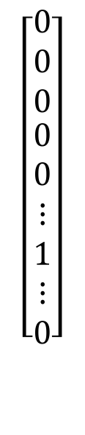
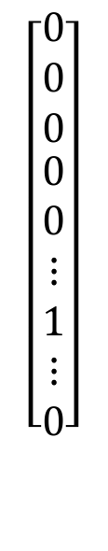
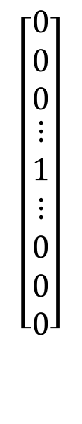
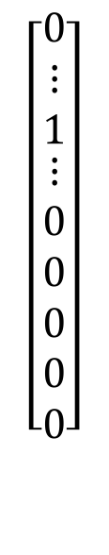
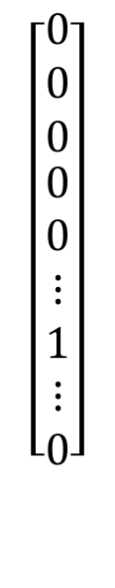
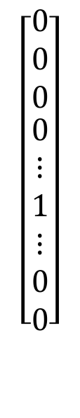
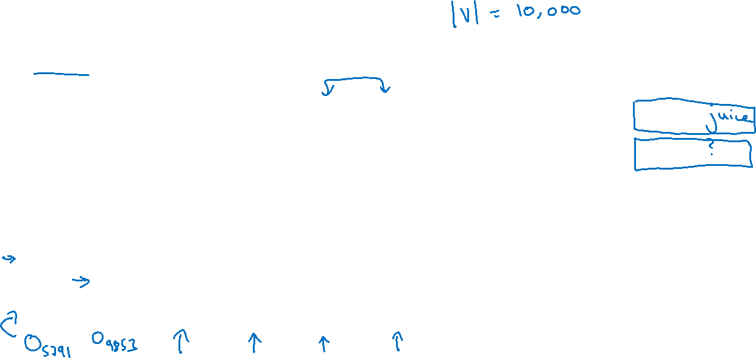
Word representation
V = [a, aaron, …, zulu, <UNK>]
1-hot representation
Man
(5391)
Woman
(9853)
King
(4914)
Queen
(7157)
Apple
(456)
Orange
(6257)
I want a glass of orange ______.
I want a glass of apple______.
$$\left[\begin{aligned}\begin{matrix}0 \\ 0 \\ 0\end{matrix} \\ 0 \\ ⋮ \\ 1 \\ ⋮ \\ 0 \\ 0\end{aligned}\right]$$
$$\left[\begin{aligned}\begin{matrix}0 \\ 0 \\ 0\end{matrix} \\ 0 \\ 0 \\ ⋮ \\ 1 \\ ⋮ \\ 0\end{aligned}\right]$$
$$\left[\begin{aligned}\begin{matrix}0 \\ 0 \\ 0\end{matrix} \\ ⋮ \\ 1 \\ ⋮ \\ 0 \\ 0 \\ 0\end{aligned}\right]$$
$$\left[\begin{aligned}\begin{matrix}0 \\ 0 \\ 0\end{matrix} \\ 0 \\ 0 \\ ⋮ \\ 1 \\ ⋮ \\ 0\end{aligned}\right]$$
$$\left[\begin{aligned}\begin{matrix}0 \\ ⋮ \\ 1\end{matrix} \\ ⋮ \\ 0 \\ 0 \\ 0 \\ 0 \\ 0\end{aligned}\right]$$
$$\left[\begin{aligned}\begin{matrix}0 \\ 0 \\ 0\end{matrix} \\ 0 \\ 0 \\ ⋮ \\ 1 \\ ⋮ \\ 0\end{aligned}\right]$$

Slide 3
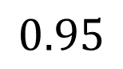
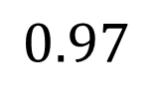
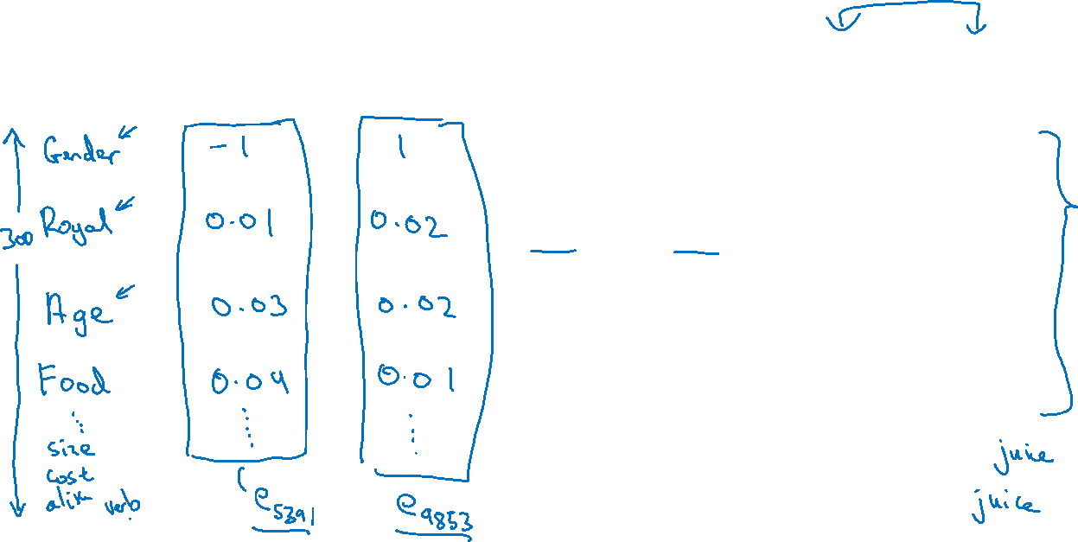
Featurized representation: word embedding
Man
(5391)
Woman
(9853)
King
(4914)
Queen
(7157)
Apple
(456)
Orange
(6257)
-0.95
$$0.97$$
0.00
0.01
0.93
$$0.95$$
-0.01
0.00
0.7
0.69
0.03
-0.02
0.02
0.01
0.95
0.97
I want a glass of orange ______.
I want a glass of apple______.

Slide 4
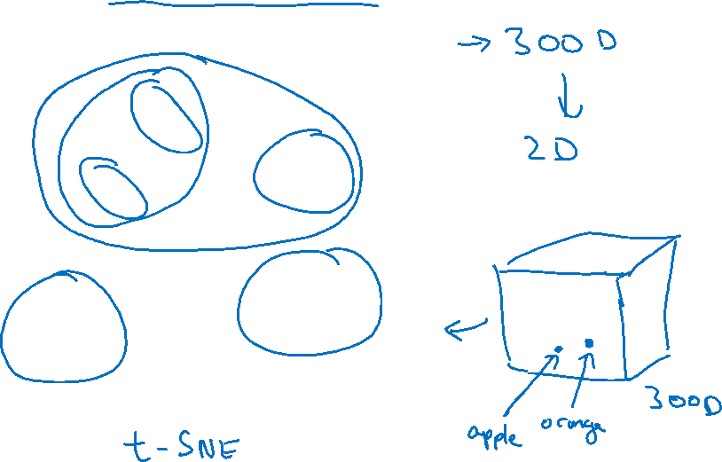
Visualizing word embeddings
man
woman
dog
king
cat
queen
fish
apple
grape
three
four
one
orange
two
[van der Maaten and Hinton., 2008. Visualizing data using t-SNE]

Slide 5
Using word embeddings

Slide 6
Named entity recognition example
$$1$$
$$1$$
$$0$$
$$0$$
$$0$$
$$0$$
Sally Johnson is an orange farmer
Robert Lin is an apple farmer

Slide 7
Transfer learning and word embeddings
Learn word embeddings from large text corpus. (1-100B words)
(Or download pre-trained embedding online.)
2. Transfer embedding to new task with smaller training set.
(say, 100k words)
3. Optional: Continue to finetune the word embeddings with new
data.

Slide 8
Relation to face encoding
$$⋮$$
$$x^{(i)}$$
$$f(x^{(i)})$$
$$\hat{y}$$
$$⋮$$
$$⋮$$
$$x^{(j)}$$
$$f(x^{(j)})$$
[Taigman et. al., 2014. DeepFace: Closing the gap to human level performance]

Slide 9
Properties of word embeddings

Slide 10
Analogies
Man
(5391)
Woman
(9853)
King
(4914)
Queen
(7157)
Apple
(456)
Orange
(6257)
Gender
$$−1$$
1
-0.95
$$0.97$$
0.00
0.01
Royal
$$0.01$$
0.02
0.93
$$0.95$$
-0.01
0.00
Age
0.03
0.02
0.70
0.69
0.03
-0.02
Food
0.09
0.01
0.02
0.01
0.95
0.97
[Mikolov et. al., 2013, Linguistic regularities in continuous space word representations]

Slide 11
Analogies using word vectors
man
woman
dog
king
cat
queen
fish
three
four
apple
grape
one
two
orange
$$e_{man}−e_{woman}≈e_{king}−e_{?}$$

Slide 12
Cosine similarity
$$sim(e_{w}, e_{king}−e_{man}+e_{woman})$$
Man:Woman as Boy:Girl
Ottawa:Canada as Nairobi:Kenya
Big:Bigger as Tall:Taller
Yen:Japan as Ruble:Russia

Slide 13
Embedding matrix

Slide 14
Embedding matrix
In practice, use specialized function to look up an embedding.

Slide 15
Learning word embeddings

Slide 16
Neural language model
I want a glass of orange ______.
$$4343$$
$$9665$$
$$1$$
$$3852$$
$$6163$$
$$6257$$
I
$$o_{4343}$$
$$E$$
$$e_{4343}$$
want
$$o_{9665}$$
$$E$$
$$e_{9665}$$
a
$$o_{1}$$
$$E$$
$$e_{1}$$
glass
$$o_{3852}$$
$$E$$
$$e_{3852}$$
of
$$o_{6163}$$
$$E$$
$$e_{6163}$$
orange
$$o_{6257}$$
$$E$$
$$e_{6257}$$
[Bengio et. al., 2003, A neural probabilistic language model]

Slide 17
Other context/target pairs
I want a glass of orange juice to go along with my cereal.
Context: Last 4 words.
4 words on left & right
Last 1 word
Nearby 1 word

Slide 18
Sentiment classification

Slide 19
Sentiment classification problem
$$x$$
$$y$$
The dessert is excellent.
Service was quite slow.
Good for a quick meal, but nothing special.
Completely lacking in good taste, good service, and good ambience.

Slide 20
Simple sentiment classification model
The dessert is excellent
$$8928$$
$$2468$$
$$4694$$
$$3180$$
The
$$o_{8928}$$
$$E$$
$$e_{8928}$$
desert
$$o_{2468}$$
$$E$$
$$e_{2468}$$
is
$$o_{4694}$$
$$E$$
$$e_{4694}$$
excellent
$$o_{3180}$$
$$E$$
$$e_{3180}$$
“Completely lacking in good taste, good service, and good ambience.”

Slide 21
RNN for sentiment classification
$$\hat{y}$$
softmax
$$a^{<0>}$$
$$a^{<1>}$$
$$a^{<2>}$$
$$a^{<3>}$$
$$a^{<4>}$$
$$⋯$$
$$a^{<10>}$$
$$e_{1852}$$
$$e_{4966}$$
$$e_{4427}$$
$$e_{3882}$$
$$e_{330}$$
$$E$$
$$E$$
$$E$$
$$E$$
$$E$$
Completely lacking in good …. ambience

